Slide 1
Control Planes for Efficient Resource Allocation in Serverless Cloud Systems Thesis Defense
Alex Fuerst; June 10th, 2024
Committee: Dingwen Tao, Eleftherios Garyfallidis,
Martin Swany, Prateek Sharma (chair)
INDIANA UNIVERSITY BLOOMINGTON

Slide 2
Outline
What is Serverless Computing / Function-as-a-Service (FaaS)?
FaaS Challenges
Low Latency via Locality
Ilúvatar Serverless Platform
Black-Box GPUs for Serverless

Slide 3
What is Serverless Cloud Computing?

Slide 4




FaaS User Flow
Serverless
Source code given to provider
FaaS
Provider
Small codebase
#Initialization code
import numpy as np
import tensorflow as tf
m = download_model(’http://model_serve/img_classify.pb’)
session = create_tensorflow graph(m)
def lambda_handler(event):
#This is called on every function invocation
picture = event[’data’]
prediction_output = run_inference_on_image(picture)
return prediction_output
HTTP-based invocation, with inputs
PUT https://faas.com/img_recogn?input=face.png
Provider returns code results

Slide 5
FaaS Provider Flow
Serverless
(1)
Load Balancer
Store
#Initialization code
import numpy as np
import tensorflow as tf
m = download_model(’http://model_serve/img_classify.pb’)
session = create_tensorflow graph(m)
def lambda_handler(event):
#This is called on every function invocation
picture = event[’data’]
prediction_output = run_inference_on_image(picture)
return prediction_output
FaaS control plane
(3)
Worker
Worker
Worker
(2)
(4)
HTTP-based invocation, with inputs
PUT https://faas.com/img_recogn?input=face.png
λ_{img_recogn}

Slide 6
Advantages
Serverless
Users assume
Stateless design
At-least-once execution
Pay-per-execution
Chainable into larger applications
No need to manage
VMs
OS Updates
Complex applications
Scaling
Idle time periods
Provider has high degree of control
Ephemeral resource allocations
Can be removed from memory
Many opportunities for optimization
Provider Adoption
AWS Lambda
Azure Functions
Google Cloud Functions
IBM Cloud Functions (OpenWhisk)
Alibaba Function Compute

Slide 7
FaaS Challenges
Serverless Challenges
Managing Sandboxing
OS Virtualization & isolation (Shillaker et al. USENIX ATC ‘20, Dong et al. ASPLOS ’20, Agache et al. NSDI ’20)
Resource Allocation (Stojkovic et al. ISCA ‘23, Akhtar et al. INFOCOM ‘20, Mvondo et al. Eurosys ‘21)
Request Orchestration
Load-balancing (Aumala et al. CCGRID ’19, Balaji et al. MLSYS ’21, Shen et al. ICDCS ‘21)
Container cache management
Moving arguments & data
Keeping track of function results/state
Request Handling
Container Init
λ Exec
Control Plane
Cold start​
Notes:
Res mgmt . Bursty figure from QoS paper . Sandboxing and resource management latency. Figure of timeline

Slide 8
Cold Starts
Serverless Challenges
If a function isn’t on a worker, we must set it up
On the critical path
This can take many seconds
Opposite is a ‘warm start’ from locality
#Initialization code
import numpy as np
import tensorflow as tf
m = download_model(’http://model_serve/img_classify.pb’)
session = create_tensorflow graph(m)
def lambda_handler(event):
#This is called on every function invocation
picture = event[’data’]
prediction_output = run_inference_on_image(picture)
return prediction_output
Worker
PUT https://faas.com/img_recogn?input=face.png
Load Balancer
Container Creation
Runtime Startup
State Load
λ_{img_recogn}

Slide 9
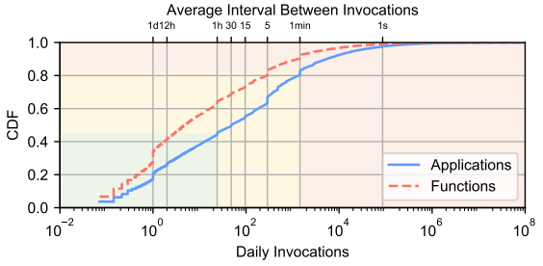
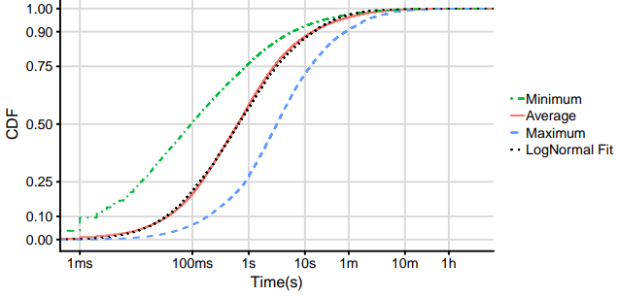
Workload Imbalance
Serverless Challenges
Large datasets have been released of serverless usage
Control plane must handle this large and heterogeneous workload
19% of functions (red) are 99% of invokes
Functions are short, but may run long
Shahrad, Mohammad, et al. "Serverless in the wild:
Characterizing and optimizing the serverless workload at a large cloud provider."
2020 USENIX Annual Technical Conference (USENIX ATC 20). 2020.

Slide 10
Why care about FaaS?
Serverless
Many Use Cases
Tens of thousands of functions
Billions of invocations per day
Deployed in many different areas
Public platforms
Edge
High Performance Computing
Private internal systems
Open-sourced designs
Adaptable to many different scenarios
Netflix
Video processing and analytics
Internet of Things
Event handling
Image processing
Web hosting
Machine learning inference
Mobile application handling
Monitoring
These varied use cases are
what we must support

Slide 11
My Work
FaasCache (ASPLOS 21) | CH-RLU Load-Balancing (HPDC ‘22)
Ilúvatar serverless platform (HPDC ‘23) | Black-Box GPU Acceleration for Serverless (Submitted EuroSys ‘25)
Cloud-Scale VM Deflation (HPDC ’20) | Memory-harvesting VMs (ASPLOS ’22)

Slide 12
Questions to Answer
What techniques help individual invocations achieve minimum latency?
How must these change to keep global latency low as we scale to billions of invocations?
How do orchestration decisions by the platform impact latency?
Locality is #1 latency factor in FaaS.
Having code and data ready to run.

Slide 13
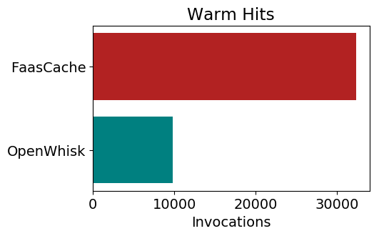

Mitigating Cold Starts w/ Keep-Alive
Locality via Container Caching
Worker cannot keep every function in memory
Decide what to remove when space is needed
Function characteristics widely vary
Use Greedy-Dual cache analogy to decide evictions
 | Start time | Runtime | Memory
ML | 4.5 s | 2 s | 512 MB
Web | 2 s | 0.4 s | 128 MB
$$KeepAlivePriority=Recency+ \frac{Frequency ∗InitTime}{Memory}$$
Fuerst, Alexander, and Prateek Sharma. "FaasCache: keeping serverless computing alive with greedy-dual caching."
Proceedings of the 26th ACM International Conference on
Architectural Support for Programming Languages and Operating Systems. 2021.

Slide 14
Load Balancer Worker Overloading
LB tracks outstanding work to get ‘load’
Functions are invoked at different frequencies
Creates high variance on used resources
20% of functions use 100x resources
If server is “full” we forward to the next
When under the load bound: pure locality
Forwarding has a high but decaying probability of warm hit
Functions influence load differently
2
0
1
[*] Mirrokni, V., Thorup, M., and Zadimoghaddam, M.Consistent hashing with bounded loads.
InProceedings of the Twenty-Ninth Annual ACM-SIAM Symposiumon Discrete Algorithms(2018), SIAM, pp. 587–604.

Slide 15
CH with Random Load Update
Locality via Load Balancing
Popular functions are identified and have increased chance of being forwarded
RLU-Forward(function, server)
L = Load(server)
if Popular(function)
L = Load(server) + N (𝜇=1/avg_IAT, 𝜎=0.1)
if L < load_bound
Run(function, server)
else
RLU-Forward(function, next(server))
3
0
Server
1
2
Follow the hash ring for locality
Fuerst, Alexander, and Prateek Sharma. "Locality-aware load-balancing for serverless clusters.“ HPDC 2022.

Slide 16
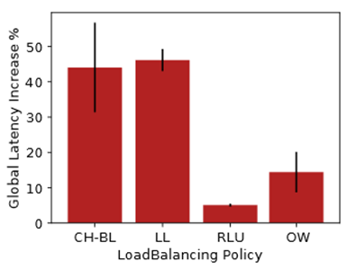
CH-RLU Global Latency Reduction
Locality via Load Balancing
Place systems under heavy load
Enough to have ~1 outstanding request per CPU in the cluster
Least-loaded eschews locality entirely
CH-Bounded Loads forwards poorly
CH-RLU outperforms all by at least 2x
Fuerst, Alexander, and Prateek Sharma. "Locality-aware load-balancing for serverless clusters.“ HPDC 2022.

Slide 17
Ilúvatar: A Fast Control Plane for Serverless Computing
My Work

Slide 18
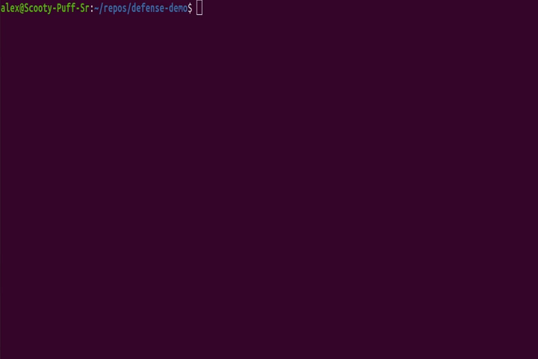
Demo!
(not live)

Slide 19
Control Planes
Related Work: Control Planes
OpenWhisk
Highly popular open-source system
Production FaaS offering of IBM
Most popular with research papers as control plane
Production open-source: OpenFaas, kNative, Nuclio
FuncX – HPC (Chard et al. HPDC ‘20)
XFaaS – Meta (Sahraei et al. SOSP ‘23)
Nightcore (Jia et al. ASPLOS ‘21)

Slide 20
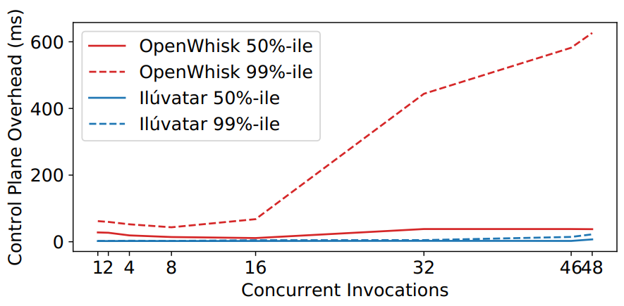
Why make Ilúvatar?
Ilúvatar
AWS, GCP, Azure not open-source any time soon
OpenWhisk a popular control plane for researchers
Open source, general purpose, maintained
Performance problems stemming from design choices
Major providers see noticeable overhead variance too
Notes:
FaaS control planes
Comment that AWS/GCP/Azure see overheads of 40-50 ms too

Slide 21
Complexity of Control Plane
Controller
Load Balancer
Worker Scaling
Function Scaling
Load Prediction
Monitoring
Billing,
Upkeep
Cluster Deployment
Worker
Worker
Container Pool
Data Movement
Workload Optimization
Ilúvatar enables easy design and experimentation in all these directions.
System Load
Queuing
Worker
Heterogeneous Compute
Worker
Sandbox Isolation
Language Runtimes
Device Control

Slide 22
Ilúvatar's Worker-Centric Design
Ilúvatar
Built from the ground-up with simplicity and latency in mind
Optimizing the common-case warm starts was high priority
Per-worker queue provides overload & overcommitment control
Load
Generator
Bypass
?
Run in Container
λ_{i}
λ_{i}
λ_{i}
λ_{i}
Concurrency Control
Container
Function
code
Agent
Load
Balancer
Worker
Container Pool:
In-use & Available
Run Function
Notes:
3. Handling overcommittment and overload via per-worker queue . Replace regulator by concurrency control

Slide 23
Container Mechanisms
Ilúvatar
FaaS requires isolating functions from one another
Tradeoff between performance, security, and complexity
Docker feature-full but slow, custom library would give most optimization
Don’t want system build around a new FaaS container
Abstract container details away from invocation and resource functionality
Allows us to support multiple mechanisms dynamically
Default to using containerd for performance & simplicity
Notes:
PS: Too abstract. Containerd also for performance. Some high vs. Low level containerization tradeoffs here (Docker has most functionality but slow, rolling our own container library would provide most optimization opportunities but time consuming, etc)

Slide 24
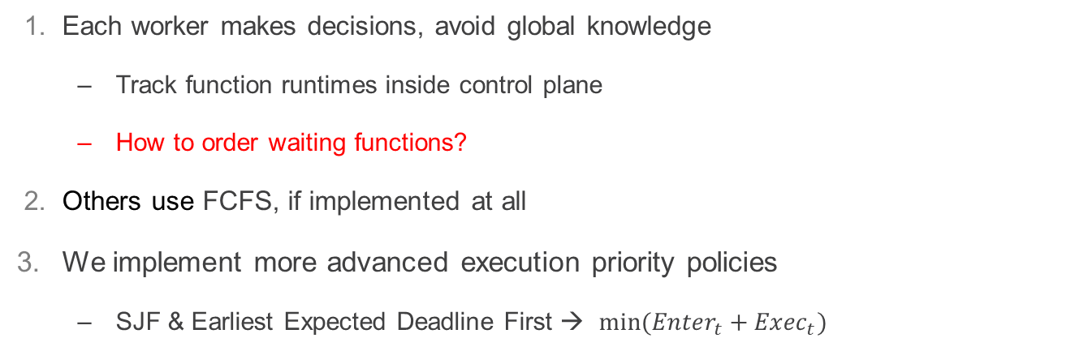
Queueing Ability
Ilúvatar
Each worker makes decisions, avoid global knowledge
Track function runtimes inside control plane
How to order waiting functions?
Others use FCFS, if implemented at all
We implement more advanced execution priority policies
SJF & Earliest Expected Deadline First → $min⁡({Enter}_{t}+{Exec}_{t})$
Run in Container
λ_{i}
λ_{i}
λ_{i}
λ_{i}
Notes:
Put queue section of worker diagram here
PS: Emphasizing per-worker instead of shared queue here is important.
Discussing the concurrency regulation mechanism is also crucial.
EEDF equation.

Slide 25
Queueing Ability, Contd.
Ilúvatar
Ability to dynamically overcommit CPU resources
Allow short functions to bypass queue
Increased throughput + Decreased wait time
Overcommitment vs waiting: why not both?
Run in Container
λ_{i}
Bypass
?
λ_{i}
λ_{i}
λ_{i}
Concurrency Control
Notes:
Put queue section of worker diagram here
PS: Emphasizing per-worker instead of shared queue here is important.
Discussing the concurrency regulation mechanism is also crucial.

Slide 26
Implementation
Ilúvatar
23k lines of Rust
No GC, fast compiler, small footprint
Maximize work done asynchronously (off invocation hot-path)
Lazy container pool for keep-alive eviction
Network namespace caching
Concurrent data structures for nearly all shared data

Slide 27
So how fast is it?
Ilúvatar
Most executions incur ~2 ms overhead from the platform
Most comes from communicating with the container
End-to-End latency
Ingestion & Queueing
Container Operations
Agent Communication
λ Execution
Returning
.076 ms
.159 ms
1.55 ms
.245 ms
Platform Overhead
~2 ms
Notes:
E2E latency

Slide 28
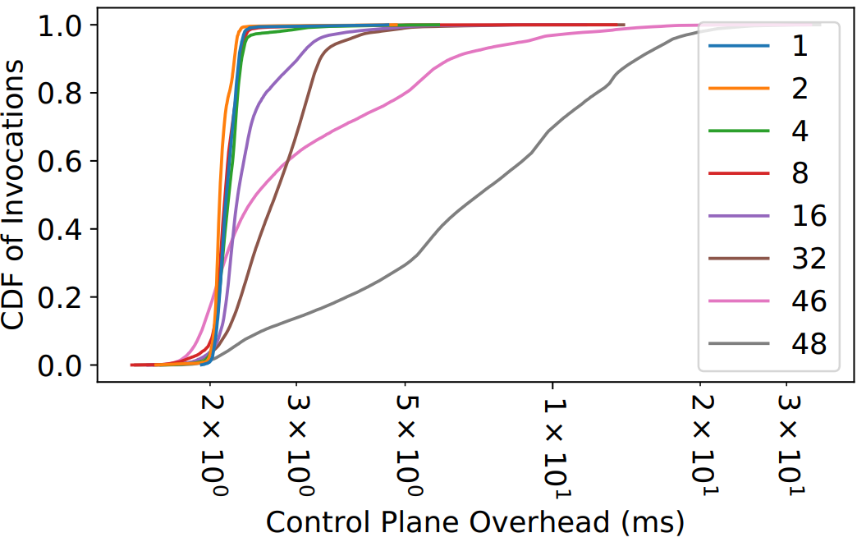
So how fast is it?
Ilúvatar
Run an increasing number of short functions (>300 ms) in a closed loop
Short time for most invocations, so a larger % of time spent in control plane
48 CPU machine.
Scales well until all CPUs are spent running short invocations
Even at full system saturation (48 threads), p99 overhead is less than 20ms

Slide 29
Research Prioritized
Ilúvatar
Built-in declarative load generation framework
Generate realistic traces with different # functions, IATs, from the full Azure trace
Run the entire system as a simulation
Real-world representative results because it’s all the same code
“null” container backend turns invocation into sleeps
Logs, logs, and (guess what) more logs
Events inside the worker, invocation latency breakdowns
Rust function-level tracing, system metrics (CPU, memory, etc.)
Open sourced for community involvement
Easy, repeatable, and comparable results

Slide 30
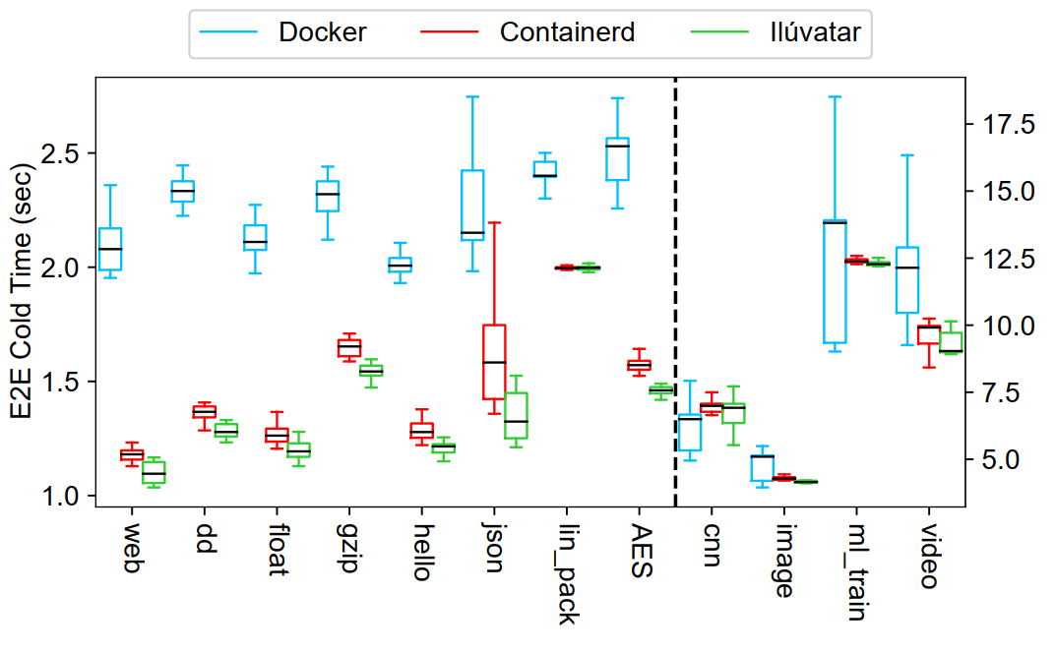
Containerization Impact
Ilúvatar in Action
Ilúvatar here uses Containerd and network namespace cache
Lower-level Containerd is faster than Docker
Simplified implementation and comparison

Slide 31
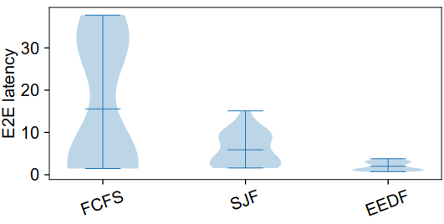
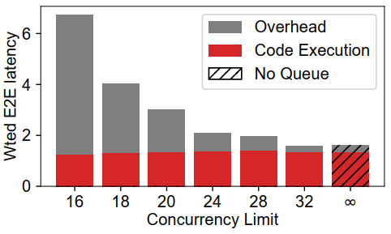
Queueing is important
Ilúvatar in Action
Long jobs can penalize short functions
Overcommitment can improve throughput

Slide 32
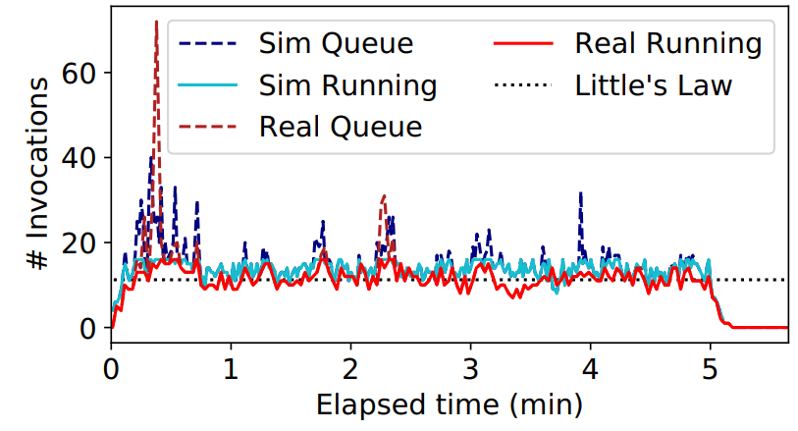
Representative simulations
Ilúvatar
Run a trace on hardware and on identically configured simulation

Slide 33
Black-Box GPU Acceleration for Serverless

Slide 34
GPUs in FaaS?
GPUs ubiquitous in cloud & edge
AI race causes hardware to become outdated
People have been moving varied applications to FaaS
ML inference & training
Video processing & analytics
Linear Algebra
Biomedical Research
Scientific computing
Function | CPU->GPU Speedup
Imagenet (CNN) | 2.5x
Roberta (NLP) | 19.3x
Ffmpeg | 7.4x
FFT | 12.9x
Isoneural (HPC) | 19.2x
Pathfinder | 91.3x
Notes:
Mention speedup is WARM TIME

Slide 35
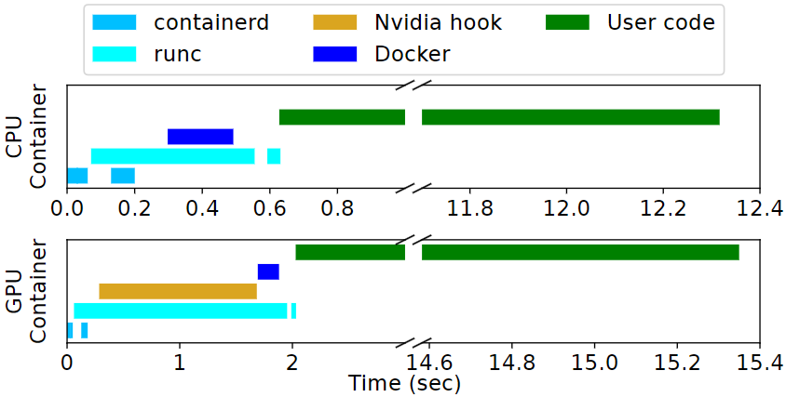
Problems with GPUs: Cold Starts
GPU startup is SLOW
OS attachment of GPU
Specialized libraries
Resource allocation on GPU
Container startup running ML code
Function | CPU (s) | GPU
Imagenet (CNN) | 6.9 | 8.58
Roberta (NLP) | 14.0 | 16.37
Ffmpeg | 0.77 | 2.04
FFT | 0.89 | 2.64
Isoneural (HPC) | 1.66 | 2.58
Pathfinder | 1.02 | 1.99
Functions see 1-3 seconds
additional cold start time

Slide 36
Problems with GPUs: Multiplexing
GPUs not designed to be shared
Calls go through 3rd party driver
Can’t maintain large number of containers for functions
A function can hog device resources while idle
Insufficient resources can cause crashes
Host has no way to control resource allocations
Heterogeneous workload are a problem
How to share access?
Frequently switching to share time between functions == fair, slow
Repeatedly run one function and block others == unfair, good latency
λ1
λ1
GPU
λ2
λ1
λ1
λ2
λ1
λ2

Slide 37
Multi-Queuing (MQFQ)
Enforce fairness between them
Functions each have a flow invocations are inserted in
Maintained by a master queue that dispatches to GPU
Virtual time (VT) denotes work received
Flows transition between states
Throttled
λ2
Inactive
Active
λ2
λ3
Flow VT
λ3
Throttle VT
λ1
λ3
λ1
Global VT
Queue
GPU
Dispatches
Mohammad Hedayati, Kai Shen, Michael L Scott, and Mike Marty. Multi-Queue Fair Queuing.
In 2019 USENIX Annual Technical Conference (USENIX ATC 19), pages 301-314, 2019.

Slide 38

MQFQ-Sticky: Locality
Adapting MQFQ for GPU
Host memory
Functions can keep state warm on-device
They see much better performance
Anticipatory scheduling
Flow kept active even when empty
Eventually times out to become idle
Flow overrun
Flow can be T units ahead of Global VT
Repeatedly select from same flow
Queue can remove device state as needed informed by flow states
λ1
GPU
λ1
λ1
Throttle
λ1
λ1
λ2
λ1
λ2
Queue
Both encourage data locality

Slide 39
MQFQ-Sticky: Dispatching
Adapting MQFQ for GPU
Need a mechanism to repeatedly pick one flow
Dispatch concurrency
Choose flow with most items
Secondary sort on least currently running
Avoids cold starts
Allows multiple flows to drain together
Maintains locality for a specific subset of flows
GPU
λ1
λ1
λ3
λ1
λ2
Queue

Slide 40

MQFQ-Sticky: Concurrency
Adapting MQFQ for GPU
GPU concurrency is limited
Functions are different sizes
Cannot easily predict usage of invocations
Dynamic device concurrency
Actively monitor GPU utilization
Adjust concurrency when there is room on device
λ1
GPU
λ1
λ3
λ1
λ2
Queue
Prevents contention and interference

Slide 41
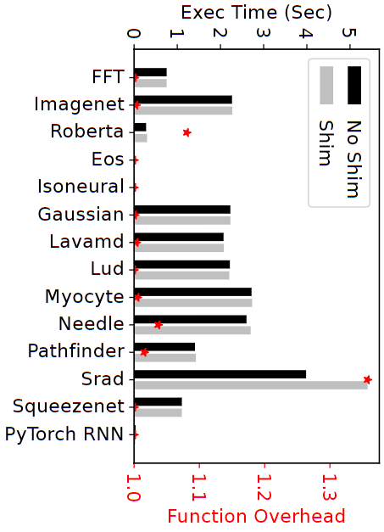
GPU Overcommitment
Proactive Memory Management
We need a way to have many containers on one device
Intercept driver memory allocation calls
Convert them into virtual memory (CUDA UVM)
Driver can move memory device←→host
We are no longer limited by device physical memory
Sandbox
User Code
Memory Shim
GPU Driver

Slide 42
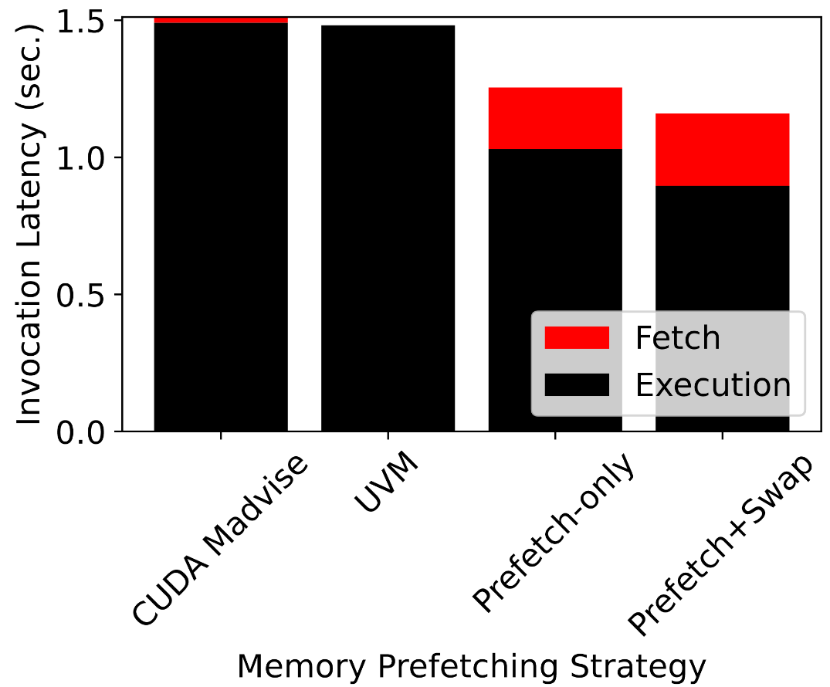
Procative Memory Movement
Proactive Memory Management
Don’t rely on driver memory swapping
We can tell CUDA where to place memory per container
Throttled & Idle queues lose device memory if we need room
Queues becoming active can have memory be moved on-device in anticipation of running
Move memory on-device before invocations
Results in ideal function execution time with no added overhead
Ideal

Slide 43
Load Management
System has multi-GPU support
Single system-wide dispatch queue
Enables load balancing – variable GPU concurrencies
Hybrid CPU+GPU scheduling
Not all code benefits from acceleration equally
Dynamic on function speedup
Helps reduce churn on GPUs
Many more CPUs available to run invocations
Queue
Queue
GPU 0
GPU 1
CPU
λ1
λ2

Slide 44
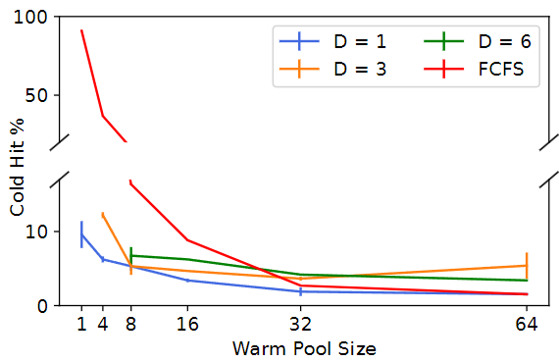
Container Pool benefits
Results
Container pool is critical for FaaS performance
New contribution of this work
Large warm pool eliminates cold starts
MQFQ locality encourages warm hits
Concurrency only slightly affects cold starts

Slide 45
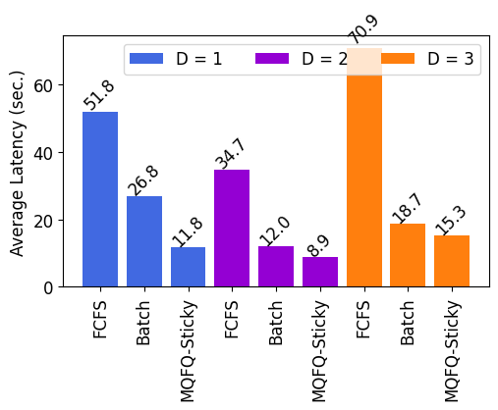
Queue Comparison
Results
Run trace with ~2 invokes/sec
MQFQ-Sticky improves latency 5x over FCFS
Data locality & cold start reduction are key
Without container pool it’s 300x
Device concurrency allows better throughput
If concurrency is too high, interference is extreme

Slide 46
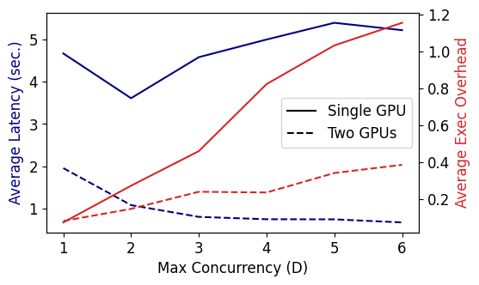
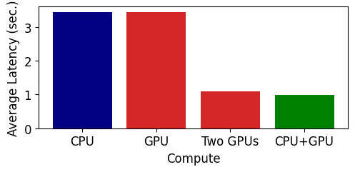
Scalability
Functions can run on just CPU
48 CPU cores gives much higher concurrency than GPU
Send to GPU those with 3x speedup
CPU + 1 GPU > 2 GPUs
Reduced GPU thrashing
System scales across heterogeneous hardware
Enables device load balancing
Latency reduced by more than 2x!

Slide 47
Thank you for coming.
Questions?

Slide 48

The Future

Slide 49
Polymorphic Functions
Functions may be able to run on CPU or GPU (think Tensorflow ML)
GPU memory resources are limited, but lots of compute
Host fewer warm containers and scale-up ability is smaller
If a function supports multiple compute modes, how do we decide what compute to run an invocation on?
How do we load-balance such functions at the cluster level?
What latency affect does scheduling to CPU have during high-GPU usage periods?
Can CPU-only functions be run on GPU using translation? We have the source code!
λ_{k}
_{GPU}
λ_{i}
λ_{i}
Container Pool
Enqueue
Policy
_{CPU}
Worker
λ_{i}
λ_{i}

Slide 50
Distributed Serverless Computing
Serverless MPI functions
Functions have no way to directly communicate
FaaS is ideal for workloads such as HPC applications written for Hadoop or MPI
Control plane creates implementations that link with existing code
Easily scale to 100s of containers for the distributed nodes
Work stealing scheduling
Worker nodes have better monitoring of local load state
Under-loaded workers can ‘steal’ invocations from over-loaded neighbors
Can be done with consistent hashing ring to maintain locality

Slide 51
Trust in Serverless
Trusted Computing Base (TCB) for FaaS users is huge
Give provider plaintext code, unknown libraries & runtime, entire software stack
Provider is running arbitrary code on their machines
Can we have end-to-end secure FaaS?
Clemmys ‘19, Cryonics ‘23, Reusable Enclaves ‘23
Challenges
Cold start cost – 512 MB memory space takes ~30 sec. in SGX
Dynamic memory allocation vs fragmentation vs speed
Many different ways of doing Trusted Execution Environments (TEEs)
SCONE ‘16, VirTEE ‘22, Graphene-SGX ‘17, HyperEnclave ’22, etc.
Where does the control plane live? Is agent in TCB?
Flexible isolation: TEE type best fit for function use case & performance

Slide 52
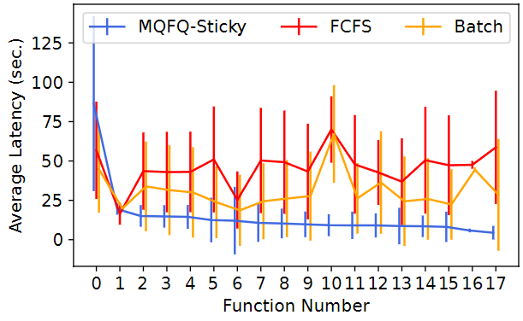
Queue Comparison (contd.)
Results
Per-function latency significantly reduced
Variance (fairness) is much better
These results are similar across 10 traces
Jitter and tail latency improve by 3x

Slide 53
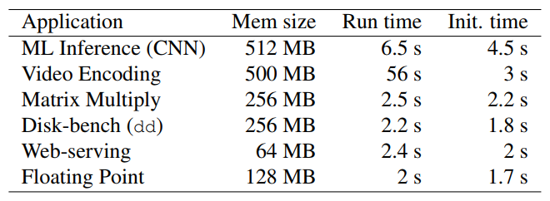
Cold Start
Serverless
PUT https://faas.com/img_recogn?input=face.png
Load Balancer
If a function isn’t on a server, we must set it up
On the critical path
This can take many seconds
Worker
Worker
[*]
λ_{img_recogn}
[*] Fuerst, Alexander, and Prateek Sharma. "FaasCache: keeping serverless computing alive with greedy-dual caching."
Proceedings of the 26th ACM International Conference on
Architectural Support for Programming Languages and Operating Systems. 2021.

Slide 54



Cold Start Time
Serverless
Cold start
FaaS
System
Container
Layer
ML Function
~.5s
~1s
~1s
Azure Functions,
AWS Lambda,
OpenWhisk, etc
Docker, VM,
Firecracker, etc
~2s
def lambda_handler(event, context): picture = event[’data’] prediction_output = infer_image(picture) return prediction_output
import tensorflow as tf m = download_model(’http://model/img_classify.pb’) session = create_tensorflow_graph(m)
Execution
Fuerst, Alexander, and Prateek Sharma. "FaasCache: keeping serverless computing alive with greedy-dual caching."
Proceedings of the 26th ACM International Conference on
Architectural Support for Programming Languages and Operating Systems. 2021.

Slide 55
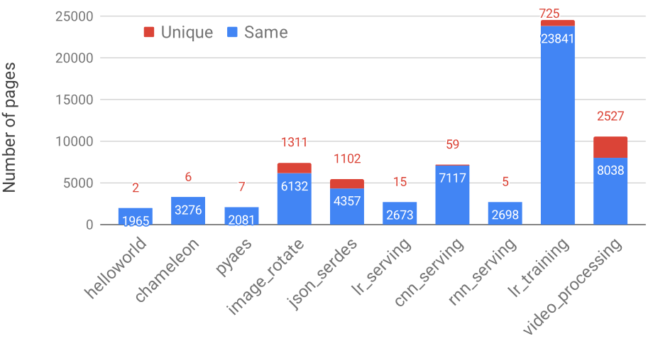
Fast Recovery?
Related Work
#Initialization code
import numpy as np
import tensorflow as tf
m = download_model(’http://model_serve/img_classify.pb’)
session = create_tensorflow graph(m)
def lambda_handler(event):
#This is called on every function invocation
picture = event[’data’]
prediction_output = run_inference_on_image(picture)
return prediction_output
Functions are (usually) non-deterministic
Stable memory access patterns
Ustiugov, Dmitrii, et al. "Benchmarking, analysis, and optimization of serverless function snapshots.“
Proceedings of the 26th ACM International Conference on
Architectural Support for Programming Languages and Operating Systems. 2021

Slide 56
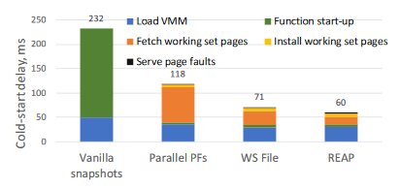
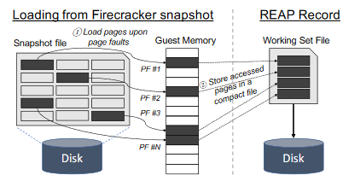
Faster Snapshots: REAP
Related Work
Do we need the whole snapshot?
Only start with it’s working set
Ustiugov, Dmitrii, et al. "Benchmarking, analysis, and optimization of serverless function snapshots.“
Proceedings of the 26th ACM International Conference on
Architectural Support for Programming Languages and Operating Systems. 2021

Slide 57
Opportunistic FaaS Cache
Related Work
Caching takes up server memory critical for functions
Options:
Have a tiny cache
Run fewer functions
Shrink existing ones
Solution → bit of everything
Selectively add items to cache
Routinely evict cache
Predict how much memory invocations need
Worker
Worker
Worker
Worker
λ₅
λ₆
Cache
λ₅
Cache
Cache
Cache
λ₃
λ₄
λ₃
λ₄
λ₃
λ₄
λ₃
λ₅
λ₆
λ₁
λ₂
λ₁
λ₂
λ₁
λ₂
λ₁
λ₂
λ₄
Mvondo, Djob, et al. "OFC: an opportunistic caching system for FaaS platforms."
Proceedings of the Sixteenth European Conference on Computer Systems. 2021.

Slide 58
Containerization Impact
Ilúvatar
Ilúvatar here uses Containerd and network namespace cache
Lower-level Containerd is faster than Docker
Simplified implementation and comparison

Slide 59
Queueing is important
Ilúvatar
Long jobs can penalize short functions
Overcommitment can improve throughput

Slide 60
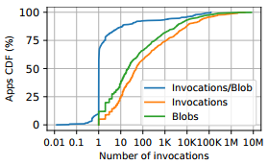
Faa$T Cache
State of Research
Serverless functions use data weird
Most access a single unique blob
Zero affinity is dominant
Only 10% access multiple blobs
1/3 of applications access a shared blob
12% of invocations always access a blob repeatedly
high affinity common
Read heavy – 77%
Romero, Francisco, et al. "Faa$T: A transparent auto-scaling cache for serverless applications."
Proceedings of the ACM Symposium on Cloud Computing. 2021.

Slide 61
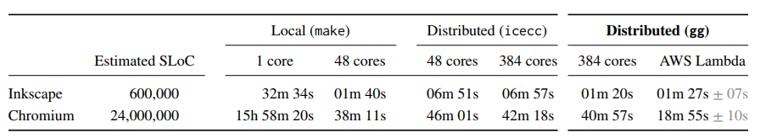
Applications: Laptop to Lambda
Serverless
Can get surprising performance
Competitive with existing comparable tools
Fouladi, Sadjad, et al. "From laptop to lambda:
Outsourcing everyday jobs to thousands of transient functional containers."
2019 USENIX Annual Technical Conference (USENIX ATC 19). 2019.

Slide 62
Baby Steps to the Cloud
Cloud
Software company wants to users to run their code
Facial recognition example:
#Initialization code
import numpy as np
import tensorflow as tf
m = download_model(’http://model_serve/img_classify.pb’)
session = create_tensorflow graph(m)
def lambda_handler(event):
#This is called on every function invocation
picture = event[’data’]
prediction_output = run_inference_on_image(picture)
return prediction_output
def handle_connection(request):
# web server handler
result = lambda_handler(request)
return_result_to_user(result)
while True:
# run a web server to accept incoming connections
request = accept_incoming_connection()
handle_connection(request)
Inference
Web
Application
Libraries
Installed OS
Physical Server

Slide 63
Self Hosting
Cloud
Scaling up requires buying more hardware
Lots of negatives for owning your own hardware
Must have employees to maintain it
Replace and update
It must physically be somewhere
Backups and emergency plans
Must own hardware for peak usage
Resource under-utilization
Inference
Web
Application
Inference
Web
Application
Libraries
Libraries
Installed OS
Installed OS
Physical Server
Physical Server

Slide 64
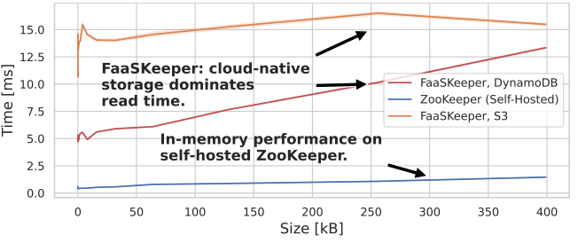
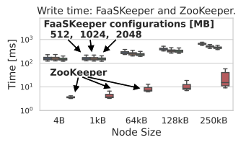
FaasKeeper Viability
State of Research
Backend limits performance and scalability
Must rely on non-optimal backend (S3 or DynamoDB)
Reads limited by remote storage
Write times are even worse comparatively
Copik, Marcin, et al. "FaasKeeper: a Blueprint for Serverless Services." arXiv preprint arXiv:2203.14859 (2022).

Slide 65
Applications
Serverless
Cost benefit → $0.50 per/run vs $19 per/hour to rent a VM
Poor scaling & need for central orchestration
Fouladi, Sadjad, et al. "From laptop to lambda:
Outsourcing everyday jobs to thousands of transient functional containers."
2019 USENIX Annual Technical Conference (USENIX ATC 19). 2019.

Slide 66
Communication
Serverless
There is no way to directly communicate between two functions
Indirect communication, say via S3, can take 100-200 ms! [1]
Or you must run your own in-memory storage system
Worker
Worker
λ_{CNN_train}
λ_{CNN_train}
[1] https://docs.aws.amazon.com/AmazonS3/latest/userguide/optimizing-performance.html

Slide 67
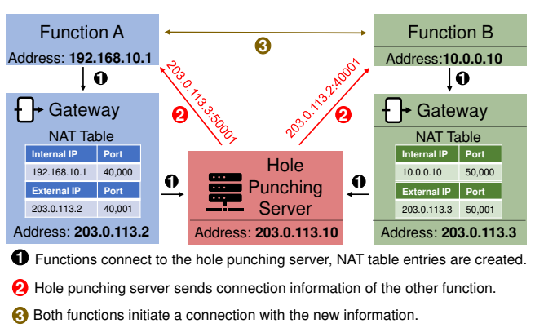
Related: FMI
Hack holes to other concurrent functions
Can communicate via MPI-like library

Slide 68
Platform MPI Support
No platform supports functions directly interacting with each other
Can indirectly via 3rd party tool
Or as part of a DAG chain passing arguments / return results

Slide 69
Keep-Alive Decision
Serverless
Init
User Code
Keep-Alive
User Code
Keep-Alive
Cold start​
Warm start​
Keep-alive tradeoff → warm starts vs cold starts
Keeping functions warm costs memory, which isn’t free
When we remove a function, cold start will happen again
Fuerst, Alexander, and Prateek Sharma. "FaasCache: keeping serverless computing alive with greedy-dual caching."
Proceedings of the 26th ACM International Conference on
Architectural Support for Programming Languages and Operating Systems. 2021.

Slide 70
Locality-Aware Load-Balancing For Serverless Clusters
My Work

Slide 71
Domain Challenges
CH-RLU
FaaS Load balancing state of the art:
Locality important for warm starts (Aumala et al. CCGRID ’19)
FaasCache maximizes warm starts at worker level (Fuerst et al. ASPLOS ‘19)
Containers are like VMs – try ML bin packing (Balaji et al. MLSYS ’21)
Larger applications should be scheduled as a DAG (Shen et al. ICDCS ’21, Kotni et al. USENIX ATC ‘21)
Competing priorities
Preserve locality
Avoid server overloading
Complex nature of the workload
Heterogenous function characteristics
Skewed nature of requests: frequent, burst, or rare
Inconsistent cluster information

Slide 72
Locality via Consistent Hashing
CH-RLU
Want a policy that encourages warm hits
Locality seems like a good way to get this
Functions map somewhere on a ‘ring’
Local server is next on the ring
Repeated functions run on the same server
3
0
Server
1
2

Slide 73
Locality via Consistent Hashing
CH-RLU
Want a policy that encourages warm hits
Locality seems like a good way to get this
Functions map somewhere on a ‘ring’
Local server is next on the ring
Repeated functions run on the same server
Amenable to server changes
Low-impact addition and removal
3
0
Server
2

Slide 74
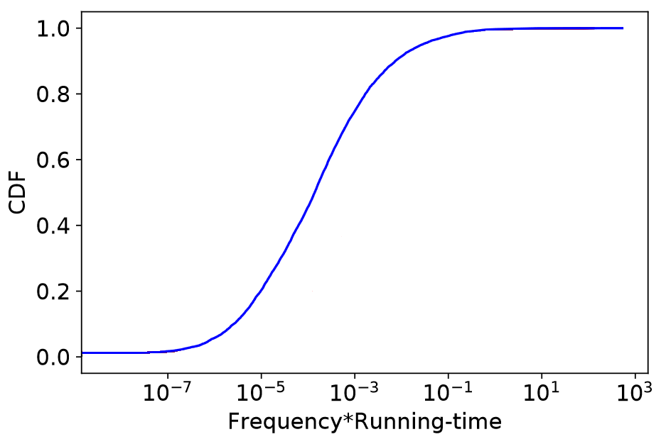
Overloading Concern
CH-RLU
Functions are invoked at different frequencies
Creates high variance on used resources
20% of functions use 100x resources
3
0
2

Slide 75
CH with Bounded Loads
CH-RLU
Assumes each item creates equal load
LB tracks outstanding work to get ‘load’
If server is “full” we forward to the next server
When under the load bound: pure locality
Forwarding has a high but decaying probability of warm hit
3
0
Domain characteristics make this not suitable for FaaS
2
[*] Mirrokni, V., Thorup, M., and Zadimoghaddam, M.Consistent hashing with bounded loads.
InProceedings of the Twenty-Ninth Annual ACM-SIAM Symposiumon Discrete Algorithms(2018), SIAM, pp. 587–604.

Slide 76
Challenge 1: Stale loads
CH-RLU
Functions do not contribute to load equally or consistently
Any load metric will be stale at load balancer
We use Linux’s load average metric to capture all work on the server
Policies assuming perfect load information can lead to violating load bound
Load
Bound
Load
Load
Actual
Load
Actual load exceeds bound
Est.
Load
Assign work here thinking estimated load will not exceed bound

Slide 77
Challenge 2: Outsized Impact Functions
CH-RLU
20% of functions account for most invocations
Invoked with high frequency, e.g. less than every second
‘Bursts’ of high frequency with periods of inactivity
These functions create violations of the load bound
We modify SHARDS reuse distance to find such functions online
Tracking the inter-arrival-time quickly detects popular functions or bursts

Slide 78
Solution: Aggressive Forwarding
CH-RLU
Popular and bursts are marked for more aggressive forwarding
Even if the server is under the load bound, forwarding can happen
Model anticipated load using Gaussian noise
Reduces overload risk for individual servers
Popular functions maintain warm hits across several servers

Slide 79
CH with Random Load Update
CH-RLU
RLU-Forward(function, server)
L = Load(server)
if Popular(function)
L = Load(server) + N (𝜇=1/avg_IAT, 𝜎=0.1)
if L < load_bound
Run(function, server)
else
RLU-Forward(function, next(server))
Popular functions have increased chance of being forwarded
3
0
Server
1
2
Follow the hash ring for locality

Slide 80
Evaluation
CH-RLU
Implemented our algorithm inside OpenWhisk
Workers’ load is propagated to load balancer via Redis cache
Workload
Functions created with code from FunctionBench ported to OpenWhisk
Function inter-arrival-times mimic Azure trace data
Our primary goal is to minimize global latency
The “optimal” case is everything running warm
And ensure no server is overloaded causing interference

Slide 81
Global Latency Evaluation
CH-RLU
Place systems under heavy load
Enough to have ~1 outstanding request per CPU in the cluster
Least-loaded eschews locality entirely
CH - Bounded loads forwards poorly
RLU outperforms all by at least 2x

Slide 82
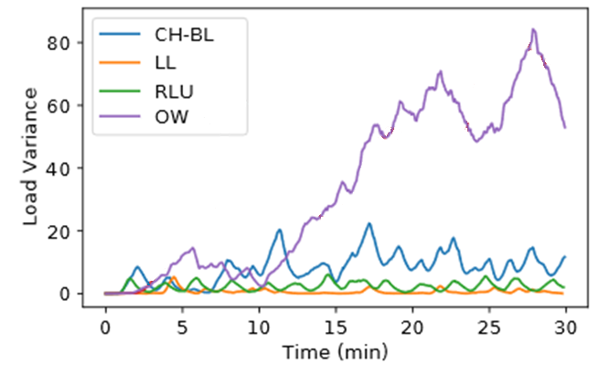
Load balancing
CH-RLU
Variance between loads on workers
OpenWhisk prioritizes locality
This causes excessive load on workers
Creates additional latency for functions
RLU is on-par with least-loaded
Server load is kept low while preserving locality for low latency

Slide 83
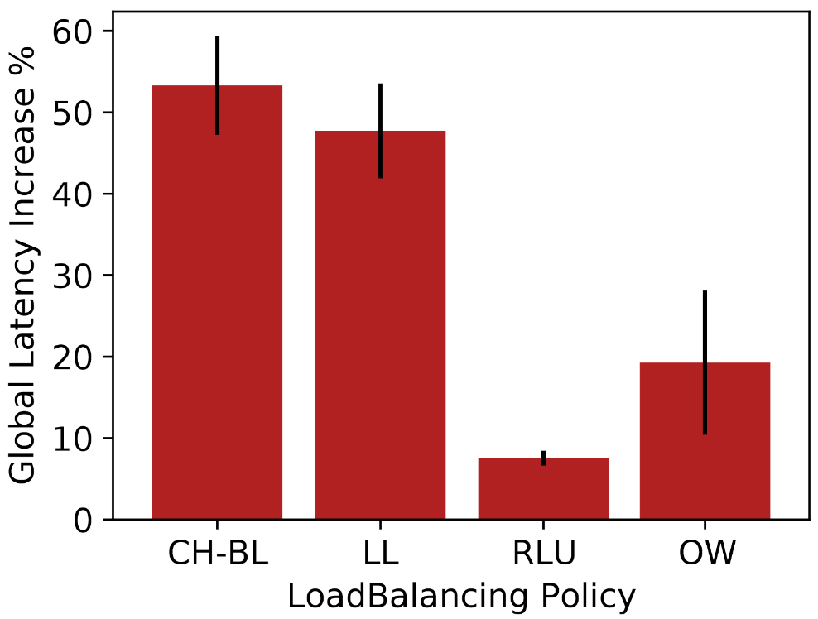
Bursty Workload Evaluation
CH-RLU
Change the frequency of functions routinely
Exercising the ability to detect changing popularities

Slide 84
Related Research

Slide 85
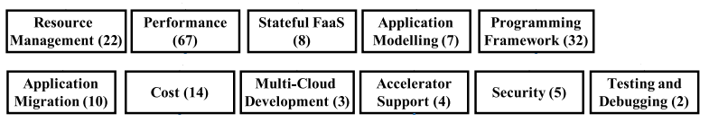
Popular Research & Usage Areas
Serverless Research: Areas
[1]
Research
[1] Wen, Jinfeng, et al. "Rise of the planet of serverless computing: A systematic review."
ACM Transactions on Software Engineering and Methodology (2023).
Uses: taken from [2]
Real-time and on-demand systems
Massively parallel tasks
Scientific computing
Management systems
Internet of Things
Streaming & video processing
[2] Shafiei, Hossein, Ahmad Khonsari, and Payam Mousavi.
"Serverless computing: a survey of opportunities, challenges, and applications.“
ACM Computing Surveys 54.11s (2022): 1-32.

Slide 86
AI in Serverless
Serverless Research: AI
Distributed learning:
λdnn – distributed DNN training (Xu et al. IEEE Transactions on Computers ‘21)
Distributed RL training (Wang et al. IEEE INFOCOM ’19)
Inference
Multi-Buffer Serving: buffer scheme in front of control plane (Ahsan et al. VLDB ‘22)
Infless: inference focused control plane (Yanan et al. ASPLOS ‘22)
Resource Management
Fireplace: placement of sandboxes (Bharathan et al. MLSys ‘21)
Sizeless: resource allocation of sandboxes (Simon et al. Middleware ’21)

Slide 87
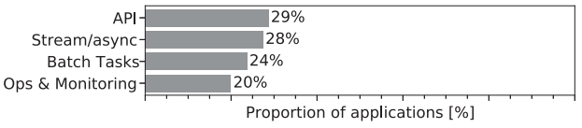
Popular Research & Usage Areas
Related Research: Areas
[1]
Research
[2]
Application
Types
[1] Wen, Jinfeng, et al. "Rise of the planet of serverless computing: A systematic review."
ACM Transactions on Software Engineering and Methodology (2023).
[2] Eismann, Simon, et al. "The state of serverless applications:
Collection, characterization, and community consensus.“
IEEE Transactions on Software Engineering 48.10 (2021): 4152-4166.

Slide 88
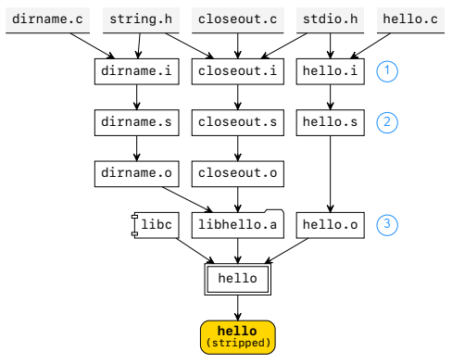
Applications: Laptop to Lambda
Related Work: Applications
Current architecture is perfect for massively parallel computation – mostly
Orchestration system to manage invocations
Think make
Each stage’s input are taken from S3
Pre-populated by setup or previous function
Fouladi, Sadjad, et al. "From laptop to lambda:
Outsourcing everyday jobs to thousands of transient functional containers."
2019 USENIX Annual Technical Conference (USENIX ATC 19). 2019.

Slide 89
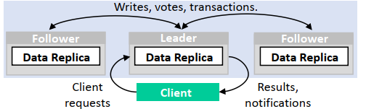
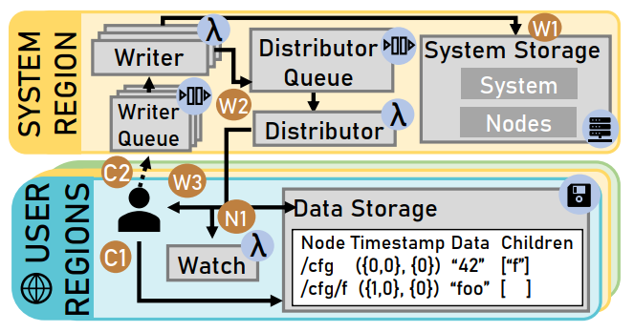
Applications: FaasKeeper
Related Work: Applications
FaaS implementation of ZooKeeper [2]
Distributed system for coordination & data persistence
Atomic & linearizable writes
Single image with notifications
Nearly all pieces are implemented in FaaS
Stateless nature requires remote storage
Atomicity done via 3rd party services
[1]
[1]
[1] Copik, Marcin, et al. "FaasKeeper: a Blueprint for Serverless Services." arXiv preprint arXiv:2203.14859 (2022).
[2] Hunt, Patrick, et al. "ZooKeeper: Wait-free Coordination for Internet-scale Systems."
2010 USENIX Annual Technical Conference (USENIX ATC 10). 2010.

Slide 90
AI in Serverless
Related Work: Applications
Distributed learning: SIREN
Inference
Infless
MBS: Multi-Buffer Serving
Resource Management
Fireplace: placement of sandboxes
Sizeless: resource allocation of sandboxes

Slide 91
Control Planes
Related Work: Control Planes
OpenWhisk
Highly popular open-source system
Production FaaS offering of IBM
Most popular with research papers as control plane
FuncX
Nightcore
OpenFaas, kNative, Nuclio

Slide 92
Load Balancing
Related Work: Control Planes
Running function on same worker avoids cold-starts
Locality important – (Aumala CCGRID ’19)
Containers are like VMs – try ML bin packing (Balaji MLSYS ’21)
Larger applications should be scheduled as a DAG

Slide 93
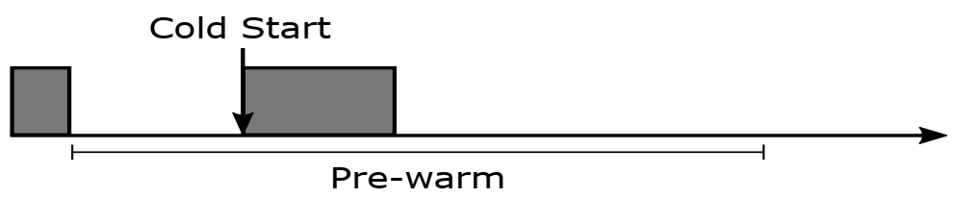
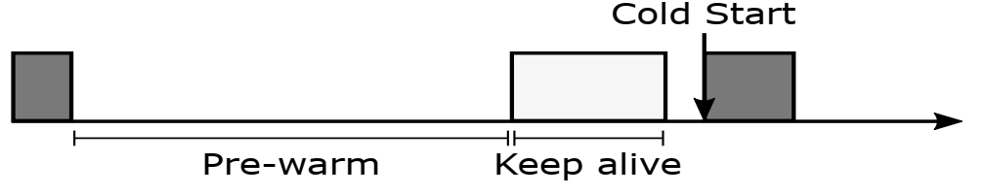
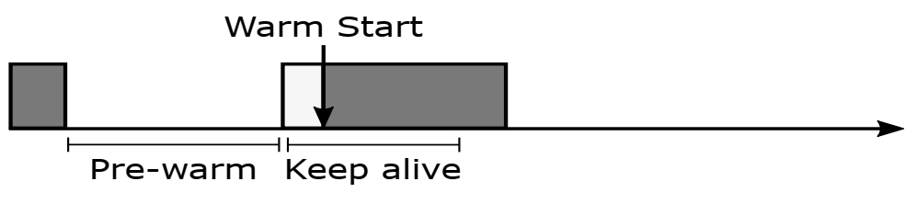
Serverless in the Wild
Related Work: Control Planes
If we can predict invocations, we can have their sandbox ready
Reducing the need to optimize startup times
Remove when we don’t expect to need it
Shahrad, Mohammad, et al. "Serverless in the wild:
Characterizing and optimizing the serverless workload at a large cloud provider."
2020 USENIX Annual Technical Conference (USENIX ATC 20). 2020.

Slide 94
Opportunistic FaaS Cache
Related Work: Control Planes
FaaS has a data-movement problem
A simple cache layer between storage
Per-worker cache for local functions
Target locality of both function and data
Lower latency on object re-use
Cloud Storage
λ
OFC
Mvondo, Djob, et al. "OFC: an opportunistic caching system for FaaS platforms."
Proceedings of the Sixteenth European Conference on Computer Systems. 2021.

Slide 95
Speedy Startup: Snapshots
Related Work: Isolation
Docker Container
Docker Container
Heap
Heap
Heap
Heap
Application
Application
Language Runtime
Disk
Language Runtime
Save to disk after first invocation
Read back on subsequent cold starts
1-2 seconds → ~250 ms
Idea first appeared in: Du, Dong, et al. "Catalyzer: Sub-millisecond startup for serverless computing with
initialization-less booting." Proceedings of the Twenty-Fifth International Conference on
Architectural Support for Programming Languages and Operating Systems. 2020

Slide 96
FAASM
Related Work: Isolation
If we minimize sandboxing, can we speed up startup?
Networking namespaces, filesystem views, images, etc.
Run everything inside a WASM process
Run each function as a thread inside a parent process
Strictly cgroups, virtual memory, and software fault isolation
Process/thread level startup time – millisecond timescale
Enabling function memory sharing
Shillaker, Simon, and Peter Pietzuch. "Faasm: Lightweight isolation for efficient stateful serverless computing."
2020 USENIX Annual Technical Conference (USENIX ATC 20). 2020.

Slide 97
FaasCache
My Work

Slide 98

Keep-Alive Akin to caching
My Work
Workers can only keep so many items warm at a time
Major providers use fixed time periods and eagerly evict things
Instead: carefully choose what to remove
Think of invocations as cache hits and misses
$$KeepAlivePriority=Recency+ \frac{Frequency ∗InitTime}{Memory}$$
Fuerst, Alexander, and Prateek Sharma. "FaasCache: keeping serverless computing alive with greedy-dual caching."
Proceedings of the 26th ACM International Conference on
Architectural Support for Programming Languages and Operating Systems. 2021.

Slide 99
FaasCache Effectiveness
My Work
Caching analogy allows experimentation with other keep-alive policies
LRU, LFU, etc.
Use ideas like hit-ratios to optimize resource allocation
Real experiments via implementation in OpenWhisk
Increase warm hits by up to 3x!
Fuerst, Alexander, and Prateek Sharma. "FaasCache: keeping serverless computing alive with greedy-dual caching."
Proceedings of the 26th ACM International Conference on
Architectural Support for Programming Languages and Operating Systems. 2021.

